Slide 1
CS4499/5599: Data Science and Applied Machine Learning
Class Lecture: April 3rd, 2023

Slide 2
Objectives
Last time:
Went over Random Forest Models
Introduced Boosting
Discussed AdaBoost
Today:
Wrap up ensembles by going over Gradient Boosting
Model Stacking
Start on Logistic Regression (if time permits)

Slide 3
Gradient Boosting
Another common model boosting technique is Gradient Boosting
Gradient Boosting works similar to Adaboost in that the algorithm sequentially adds predictors to correct errors
However, instead of adjusting the weights after every iteration, Gradient Boosting attempts to fit the new predictor to the residual error made by the preceding prediction
As was the case with Adaboost, we can use Gradient Boosting for either regression or classification

Slide 4
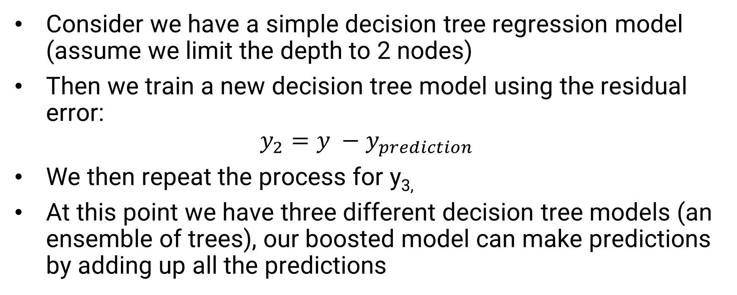
Gradient Boosting Example
Consider we have a simple decision tree regression model (assume we limit the depth to 2 nodes)
Then we train a new decision tree model using the residual error:
$$y_{2}=y −y_{prediction}$$
We then repeat the process for y_{3,}
At this point we have three different decision tree models (an ensemble of trees), our boosted model can make predictions by adding up all the predictions

Slide 5
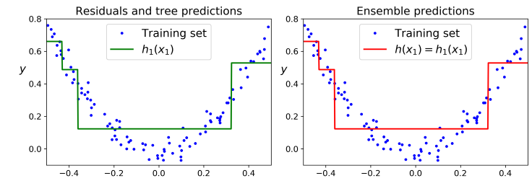
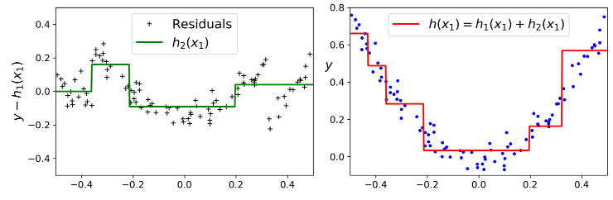
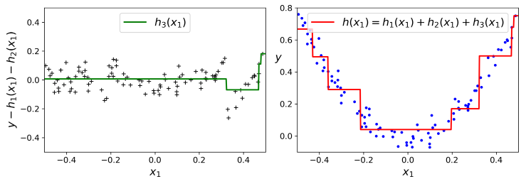

Slide 6
Gradient Boosting Example
Sklearn has a Gradient boosting class that will do most of this for us sklearn.ensemble.GradientBoostingClassifier or sklearn.ensemble.GradientBoostingRegressor
It’s important to note that Gradient Boosting models act in a similar way as a decision tree, as such we can control hyperparameters such as:
The max depth
Minimum samples leaf
The number of estimators (number of trees)
Learning rate

Slide 7
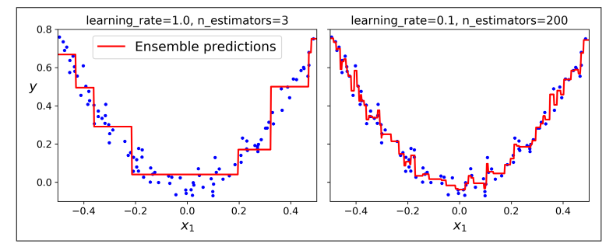
Considerations for Gradient Boosting
One issue with Gradient Boosting is determining the optimal balance between learning rate and the number of trees

Slide 8
Considerations for Gradient Boosting
Reducing the learning rate generally results in better predictions, but will require more trees, this is usually referred to as shrinkage
However, too many trees will likely lead to the model becoming severely overfit
Sklearn has a number of strategies we can use to help find optimal value for these hyperparametes:
Use the stage_predict() method,
Early Stopping
Incremental Training

Slide 9
XGBoost
While sklearn has a useful Gradient Boosting class, the Python package XGBoost is even better
XGBoost or Extreme Gradient Boosting is an optimized approach for Gradient Boosting which is faster, easier to scale and more portable than other algorithms
According to NVIDA, XGBoost has been used in all winning models in Kaggle data science competitions
XGBoost is very open and versatile, can be used with almost every environment used in data science

Slide 10
XGBoost
Another advantage of XGBoost, is that the package is designed to work with GPUs
There are several types of machine learning models that work better with GPUs rather than a CPU (more on this later)
The API is designed in a way that is very similar to Sklearn, so training models with XGBoost should not be too difficult
Google Colab already has XGBoost installed, so you can use it without making any changes
XGBoost documentation:
https://xgboost.readthedocs.io/en/stable/index.html

Slide 11
Stacking
The final approach to ensemble learning, we will go over for know is stacking generalization or just stacking
With stacking we still want to perform an aggregation of several learners,
However, instead of performing this after training through majority vote, stacking looks to perform the aggregation through model training
We still train our models to get our predictions, but then we use a meta-learner or “blender” to use these values to determine our final prediction

Slide 12
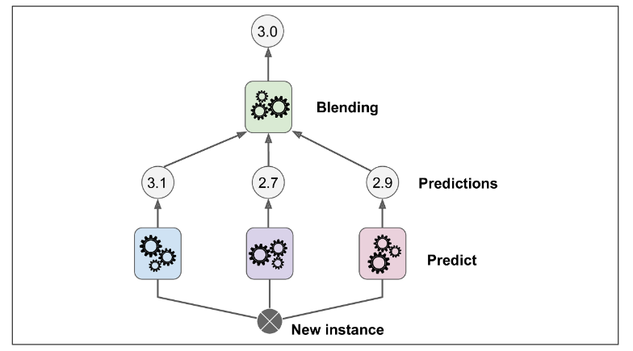
Stacking
Visualization of a Stacking model from Geron

Slide 13
Stacking
Typical stacking algorithms usually set aside a sub-set of data known as a “hold-out” set
The first sub-set of data is used for our initial training, the hold-out set is then used for predictions
These predictions can then be used in training, creating the next training set, which is then used to train the blender
If desired, we could have multiple blenders, to bring together results from different model types
Sklearn at last look doesn’t support stacking, but there are open-source options like DESlib that could be used

Slide 14
Summary of Ensemble Learning
Ensemble learning is a powerful technique in machine learning regardless of the type of model you are training
There are several different approaches that you can use and even more hyperparamters you can tune to train your model
As is the case with most things in machine learning, the best approach for ensemble learning is data dependent
Of the approaches we discussed the most common are probably random forest, AdaBoost and XGBoost

Slide 15
Moving Forward
For the next few classes, we are going to shift gears and discuss other types of classification models
With advancements in neural network models, there are some who will say these approaches are outdated
This is simply not true, while neural network models have powerful applications, the techniques we will discuss can still produce effective models
These models can also much quicker to train and are much easier to explain and visualize

Slide 16
Logistic Regression
The first of these techniques we will cover is logistic regression
Although the name suggest this would a regression model, it is actually much better suited for classification
Logistic regression is used to estimate the probability that an instance belongs to a class
Although logistic regression was originally intended only to be a binary classifier, there are approaches we can use to make it multi-class

Slide 17


Logistic Regression
Logistic regression is similar to linear regression in that a model calculates the weighted sum of the input data
However, this is used to calculate a probability using this equation:
The logistic (σ) is a sigmoid function that outputs a number between 0 and 1

Slide 18
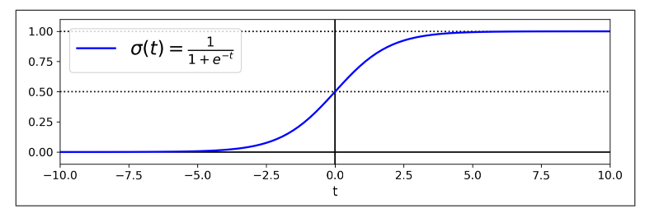
Logistic Regression
The graph of the logistic function looks like:
Assuming binary classification, the classification can be done easily once the probability is calculated

Slide 19

Logistic Regression
If the probability value is less than 0.5 than the instance is classified to be false, otherwise it is classified as true
The goal of the classifier is to set the parameter vector θ so that our model estimates high probabilities for true instance and low for false
We can use this cost function (for a single instance) to do so:
–log(t) grows large as t approaches 0, so cost will be large if a probability close to 0 is estimated (for a true instance)

Slide 20

Cost Function
The cost function for the entire training set is:
Now its important to note that there is no closed form o this equation to minimize θ
However, using an optimization method (i.e., a calculus-based method) you will find a global min (the function is convex)
The potential issue is you will might just have to wait a bit to find (in many cases this can increase the training time significantly)

Slide 21
Next Time
Continue with logistic regression
Multi-class classification with Logistic Regression
Start going over k-nearest neighbors
Homework 7 will be assigned during the next class

